Slide 1
Prediction Challenge #1
Ali Awari

Slide 2
Finding indicators/patterns
SCORE ~ GRADE ~ PARTICIPATION ~ LEAVING EARLY ~ ASKING QUESTIONS

Slide 3
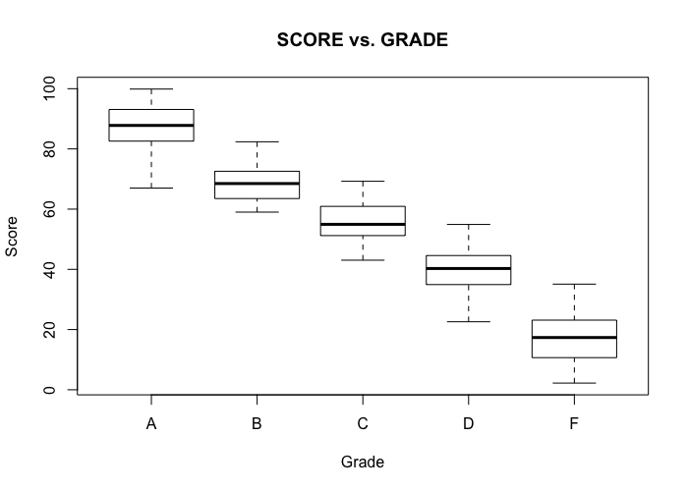
Score vs. Grade
From this boxplot, it is clear that scores has a direct influence over grades.

Slide 4
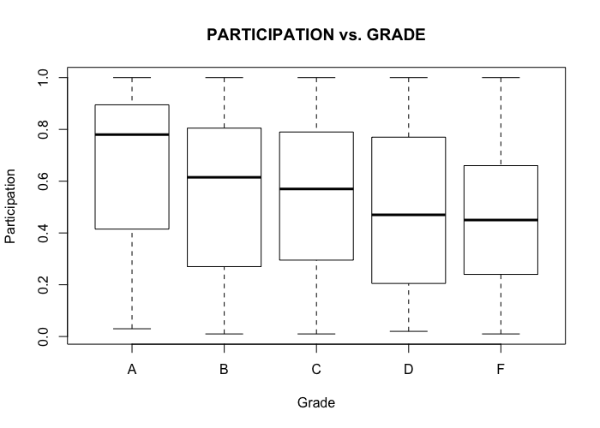
Grade vs. Participation
There is a less pronounced pattern in participation relative to grade.

Slide 5
Checking other stuff out.
table(subset(M2018_train, GRADE == "A")$ASKS_QUESTIONS)
always never sometimes
83 59 61
table(subset(M2018_train, GRADE == "A")$LEAVES_EARLY)
always never rarely
66 80 57
There may be a pattern here, but if one were to model this, I believe it will create an over-fit model

Slide 6
Maximums & Minimums
Using:
summary(subset(M2018_train, GRADE == ”Letter”)$SCORE)
Max: 99.88 & Min: 66.99 = A
Max: 82.37 & Min: 59.01 = B
Max: 69.25 & Min: 43.04 = C
Max: 54.91 & Min: 22.59 = D
Max: 35.09 & Min: 2.22 = F
Minimum isn’t useful here, but maximum provides ranges of numbers

Slide 7
Taking a deeper look at the overlap cases.
There is a clear overlap of minimums and maximums in scores between different grades.
What could cause this overlap? My initial hypothesis was that the less pronounced pattern, participation, or leaving class / asking questions, influenced these grades.
I could not find a strong indication that asking questions or leaving class influenced these overlap grades, however participation, in a small but significant amount of cases showed such indication of changing grades.

Slide 8
Logic: using computers to predict

Slide 9
Building a model
The following logic stems from my attempt to encapsulate the default ranges, with the overlap grades, including playing around with the numbers.
[SCORE >= 23 & PARTICIPATION >= .51] <- ‘D’
[SCORE >= 34] <- 'D'
[SCORE >= 43 & PARTICIPATION >= .55] <- 'C'
[SCORE >= 52] <- 'C'
[SCORE >= 59 & PARTICIPATION >= .51] <- 'B'
[SCORE >= 68] <- 'B'
[SCORE >= 73 & PARTICIPATION >= .51] <- 'A'
[SCORE >= 80] <- 'A'

Slide 10
Error(s)
After cross validating, and using the test dataset. I arrived at an error level that I am satisfied with.
I understand some will individuals will have a significantly lower error compared to mine (equal to or lower than 2%) but I am satisfied with my error.
6.75%

